Slide 1

Blinkit: India's Last-Minute
App - Insights Report
An overview of key sales and operational metrics

Slide 2
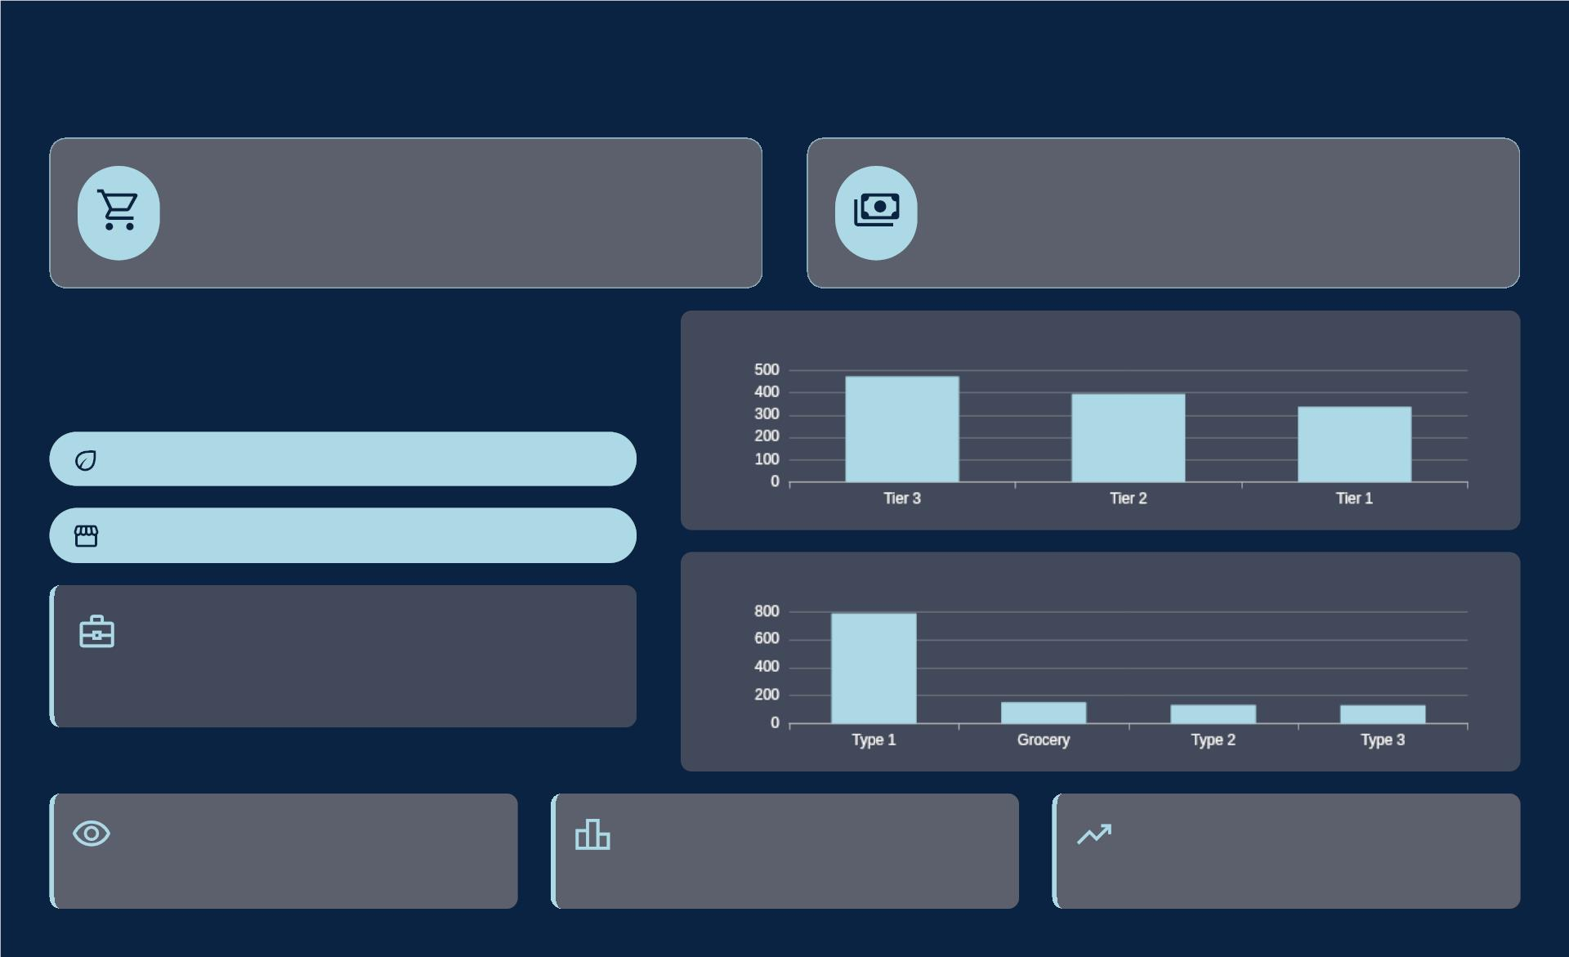
Blinkit's Sales Performance: Strategic Summary
$1.2M
$141
Total Sales
Avg. Transaction
Sales by Location Tier
Performance Highlights
Low Fat Items Preferred
Medium & High Outlets Top Contributors
Sales by Outlet Type
Outlet Dominance
Supermarket Type 1 leads in performance, indicating
strong market presence and efficiency.
Consumer Focus
Strategic Deployment
Geographic Growth
Deepen understanding of low-fat item demand to
optimize product assortment.
Prioritize resource allocation to high-performing
medium and high-sized outlets.
Leverage success in Tier 3 locations to identify
similar high-potential areas.

Slide 3

Overall Performance Metrics
$1.2M
$141
Total Sales Revenue
Avg. Transaction Value
8,523
4.0
Units Sold
Customer Satisfaction

Slide 4
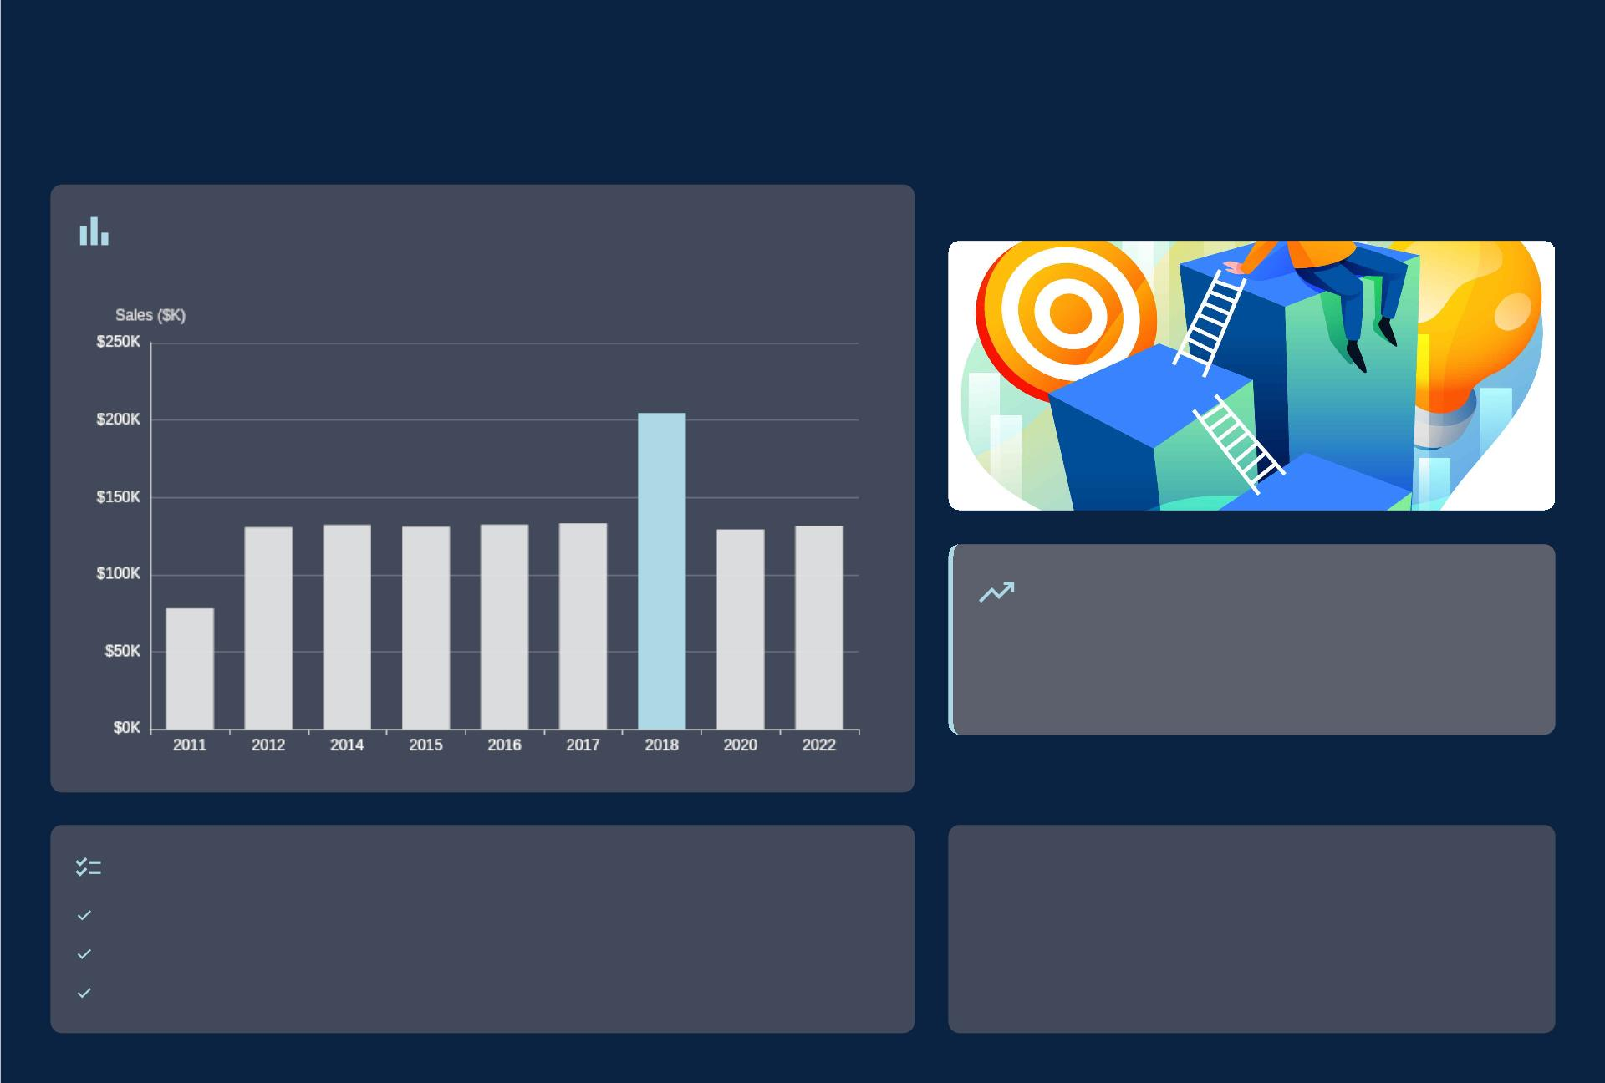
Outlet Establishment Year
04
vs. Sales
Sales Performance by Establishment Year
Growth Catalyst: 2018 Outlets
Outlets from 2018 show exceptional sales.
Achieved $204.5K, leading all cohorts.
Indicates successful market entry and scaling.
Analytical Focus
Analyze sales trends by establishment year.
"Insights drawn from comprehensive Blinkit sales data analysis."
Compare performance across different outlet vintages.
Identify high-impact cohorts for strategic replication.

Slide 5
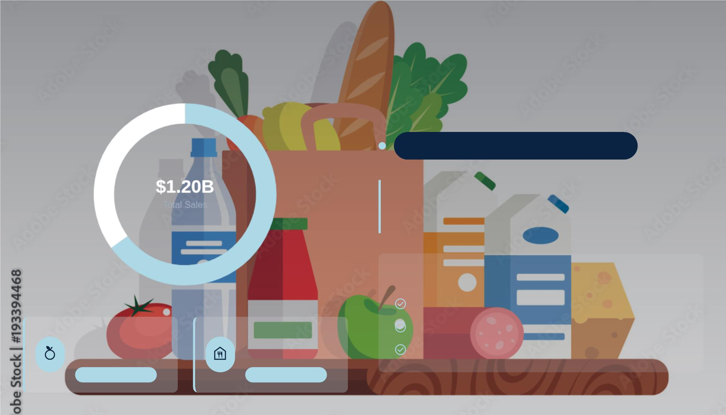
Sales Distribution by Fat Content
Sales Mix by Fat Content
Key Consumer Preferences
Strong Consumer Preference for Low Fat
This distribution clearly indicates a significant market
inclination towards low-fat options, shaping purchase
behaviors.
Strategic Implications
Prioritize low-fat product development & inventory.
Tailor marketing to health-conscious segments.
Low Fat Items
Regular Fat Items
$776,320K
$425,362K
Identify growth opportunities in high-demand categories.
65% of Total Sales
35% of Total Sales

Slide 6

Top Performing Item Types by Sales
6
Sales Contribution by Item Type
Consumables Lead Market Share
Fruits & Vegetables: $178.1K
Snack Foods: $175.4K
Household: $136.0K
Frozen Foods: $118.6K
Dairy: $101.3K
Fresh & Healthy Growth
Snack & Convenience Power
Stable Household Demand
Consistent demand for fresh produce drives top-
tier sales performance.
Snack foods highlight the strong impact of
impulse and everyday purchases.
Household items provide a robust baseline,
reflecting essential consumer needs.
High Margin
Customer Loyalty
Frequent Buys
Impulse Driven
Essential Goods
Steady Revenue

Slide 7
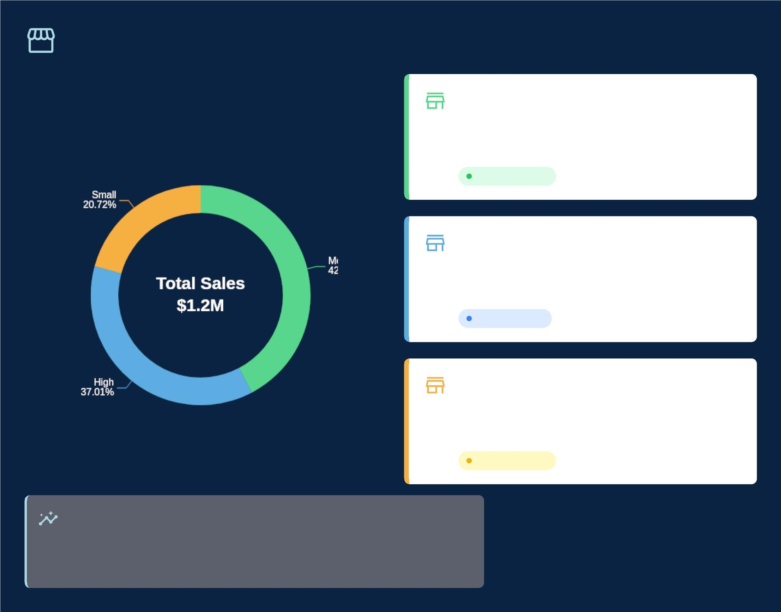
Sales Performance by Outlet Size
Medium Outlets
$507.9K
Sales Contribution
42% of Total Sales
Revenue Leader
High Outlets
$444.8K
37% of Total Sales
Key Contributor
Small Outlets
$249.0K
21% of Total Sales
Growth Potential
Impact Analysis
Outlet size is a primary driver of sales volume. Strategic focus on medium and high-
sized formats yields the highest returns, while small outlets are key for market
penetration.

Slide 8
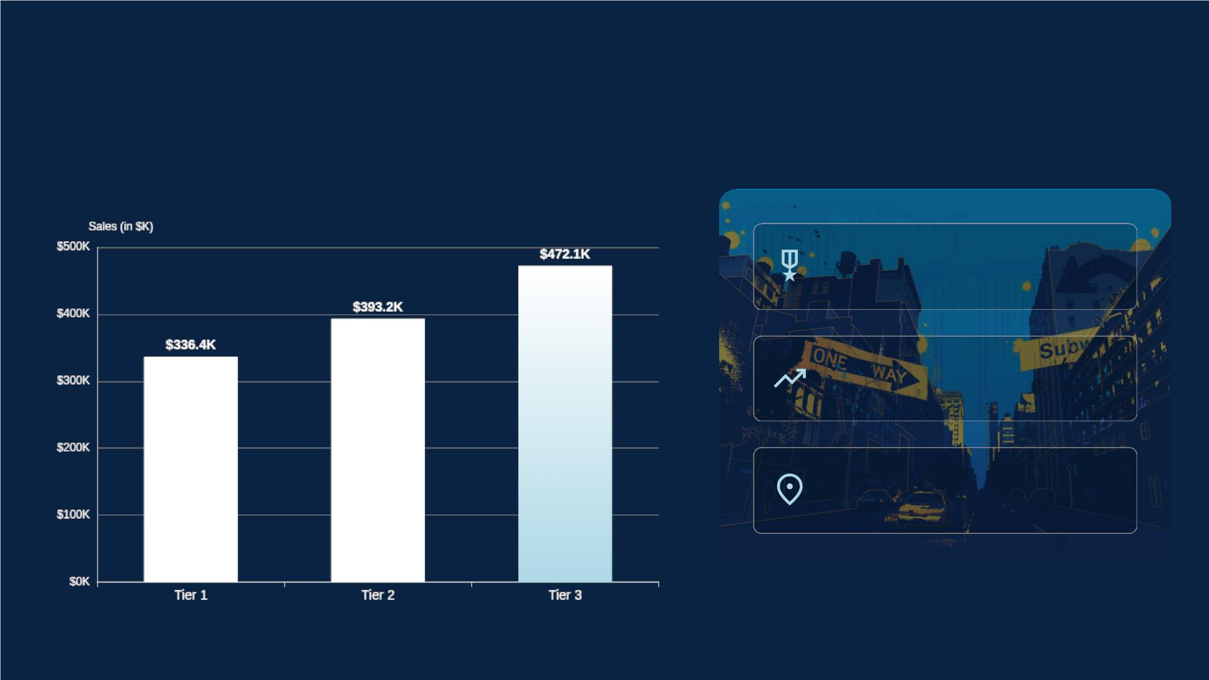
Sales Performance by Outlet Location Type
Total Sales by City Tier
Tier 3: $472.1K
Leading Performance
Tier 2: $393.2K
Strong Regional Presence
Tier 1: $336.4K
Strategic Footprint for Growth

Slide 9
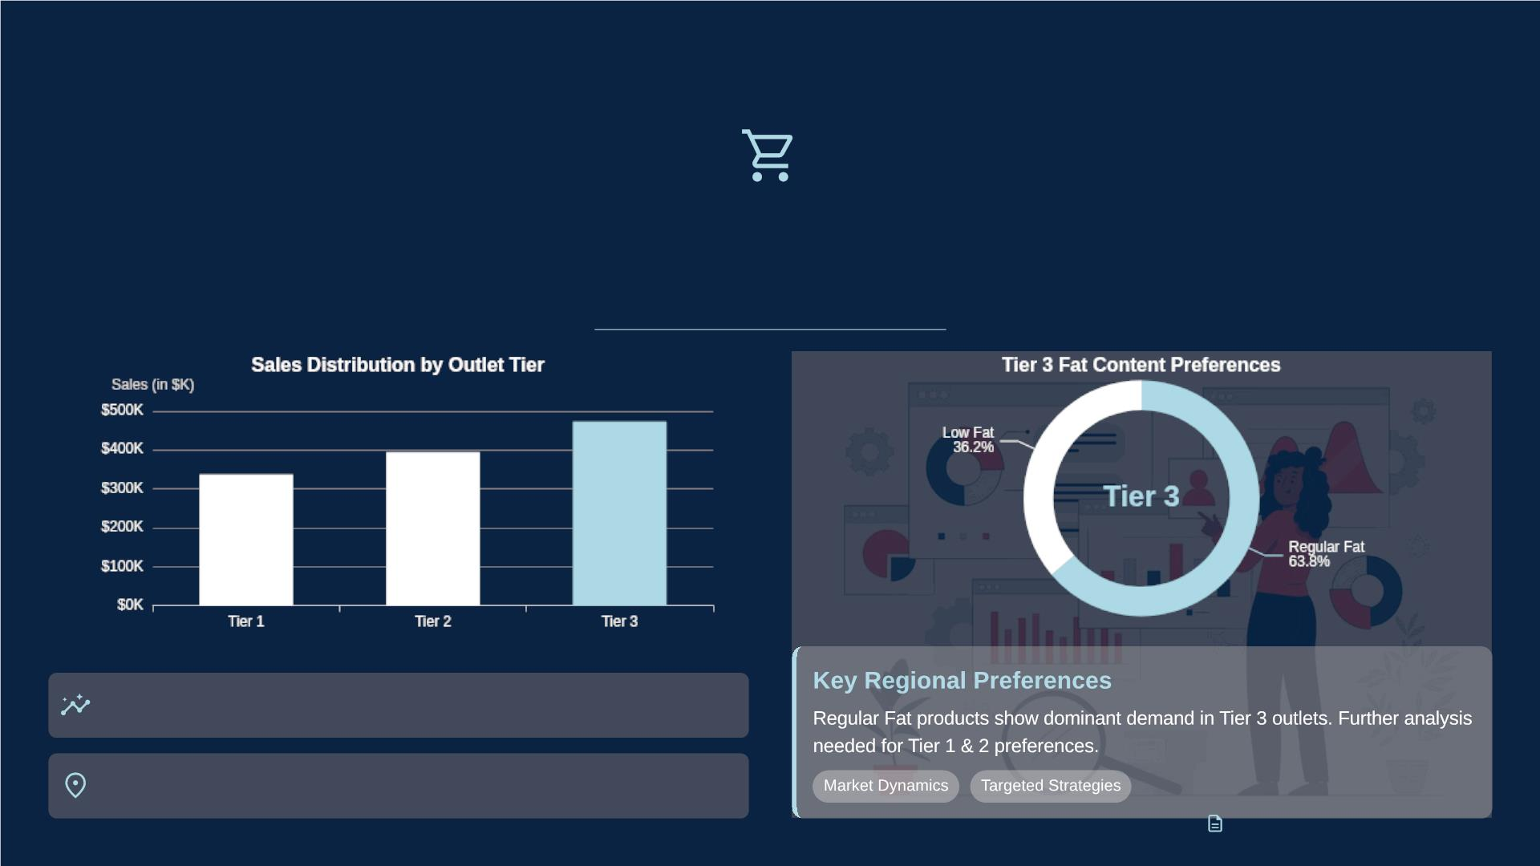
Fat Content Sales by Outlet Location
$322.1M
Total Fat Content Sales Across All Locations
Tier 3 leads in overall sales contribution.
Key locations drive distinct sales patterns.

Slide 10
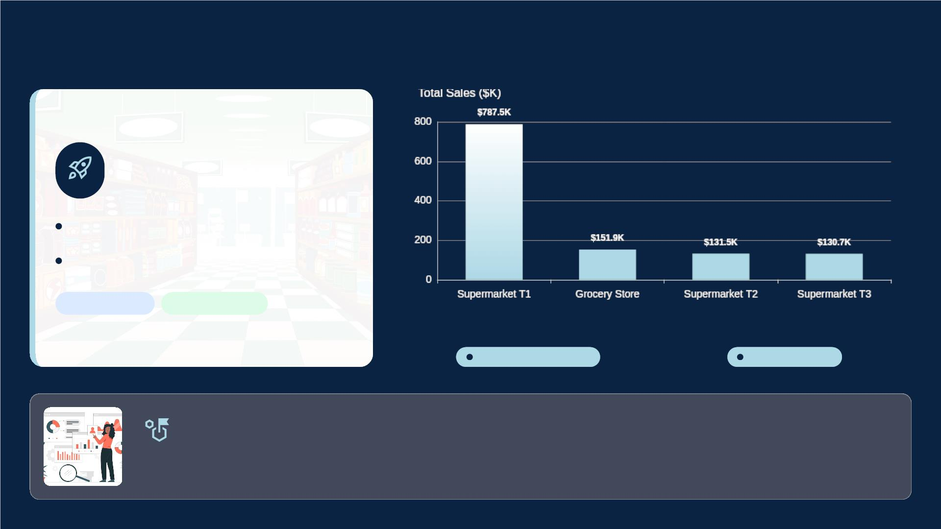
Outlet Type Performance Analysis
Supermarket Type 1
Leads
Total Sales:
$787.5K
Strong Average Sales
Top Performer
Revenue Driver
Grocery Stores
Supermarket Type 3
Significant Contribution
Emerging Volume
Strategic Imperative:
Understanding performance across different outlet types is crucial for optimizing future strategies and
resource allocation.

Slide 11
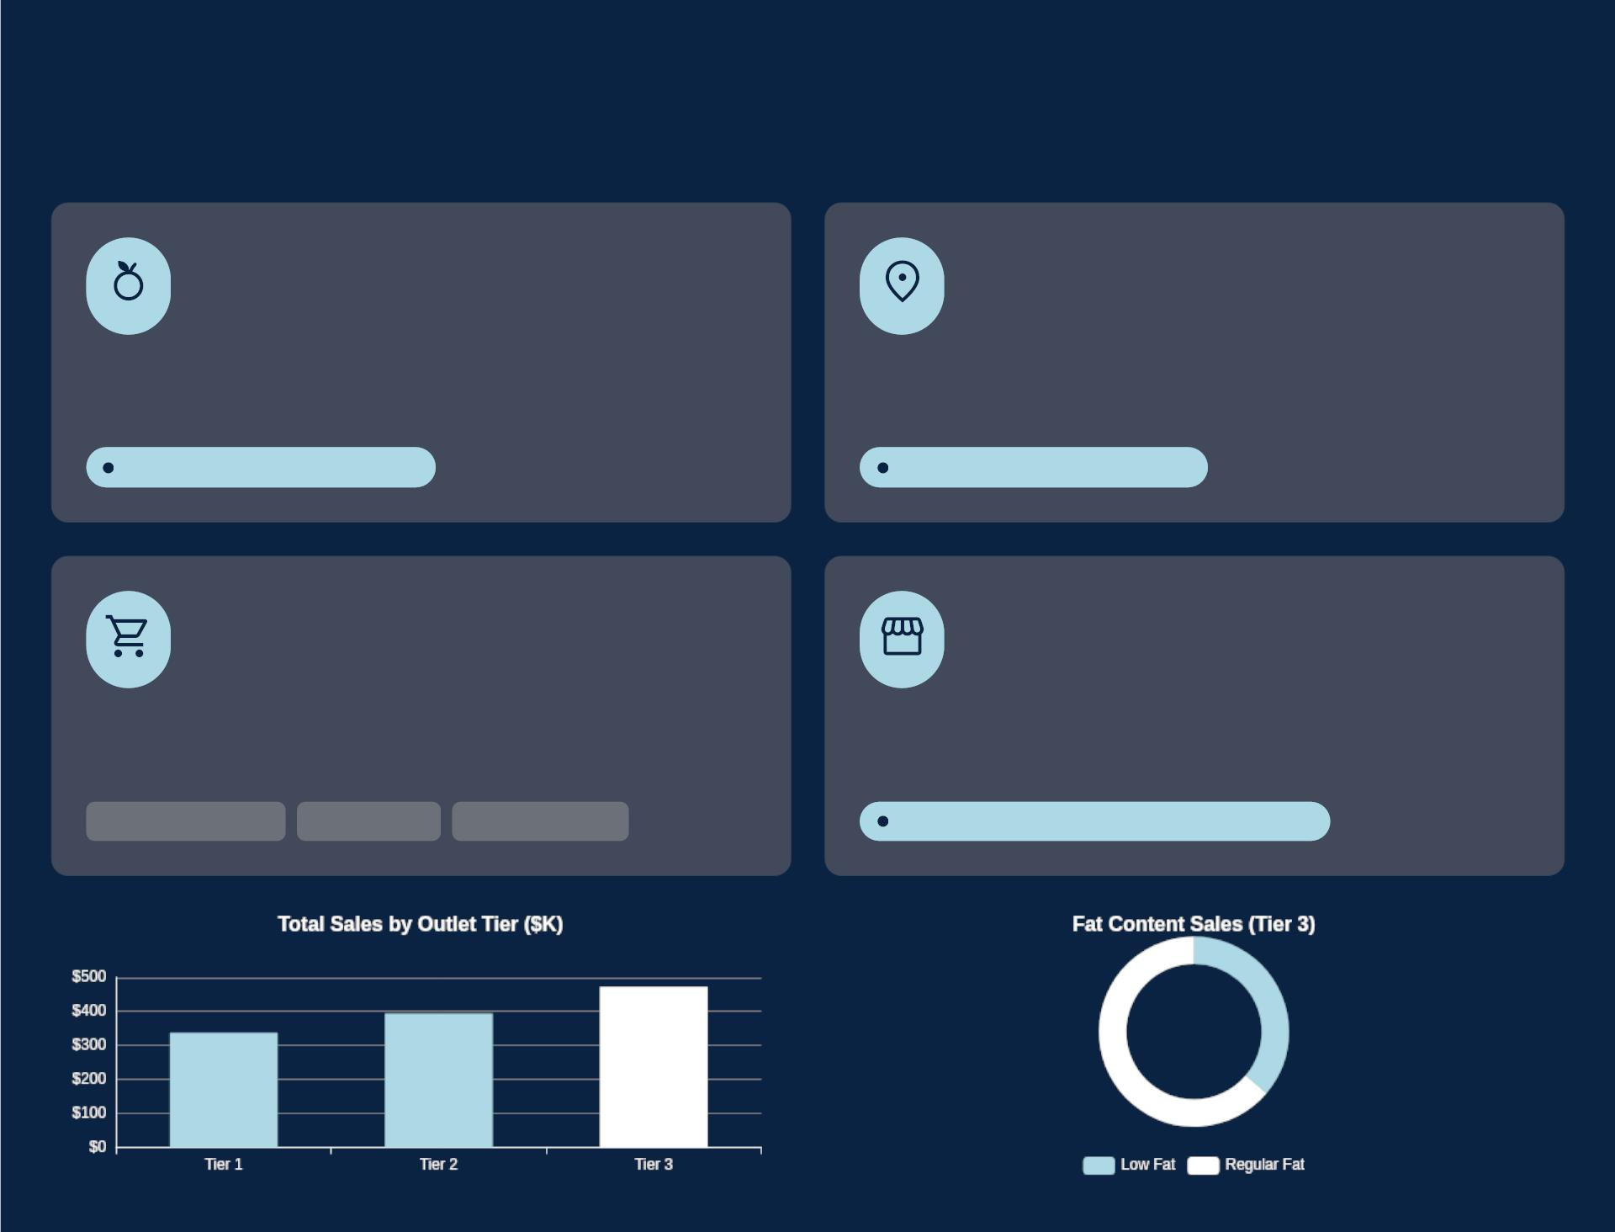
Strategic Recommendations
Actionable insights to drive Blinkit's continued growth and optimize market presence.
Prioritize Low-Fat Products
Maximize Tier 3 Market
Leverage significant sales contribution from low-fat items by
boosting inventory and promotional efforts.
Capitalize on leading sales from Tier 3 outlets through targeted
marketing campaigns and enhanced logistics.
Accounts for 65% of total sales
Leads with $472.1K Total Sales
Boost Core Categories
Expand High-Yield Outlets
Increase inventory and focused promotions for high-performing
categories to meet demand.
Explore expansion into medium and high-size outlet formats,
aligning with their higher sales generation.
Fruits & Vegetables
Snack Foods
Household Items
Medium/High formats generate 79% of sales

Slide 12
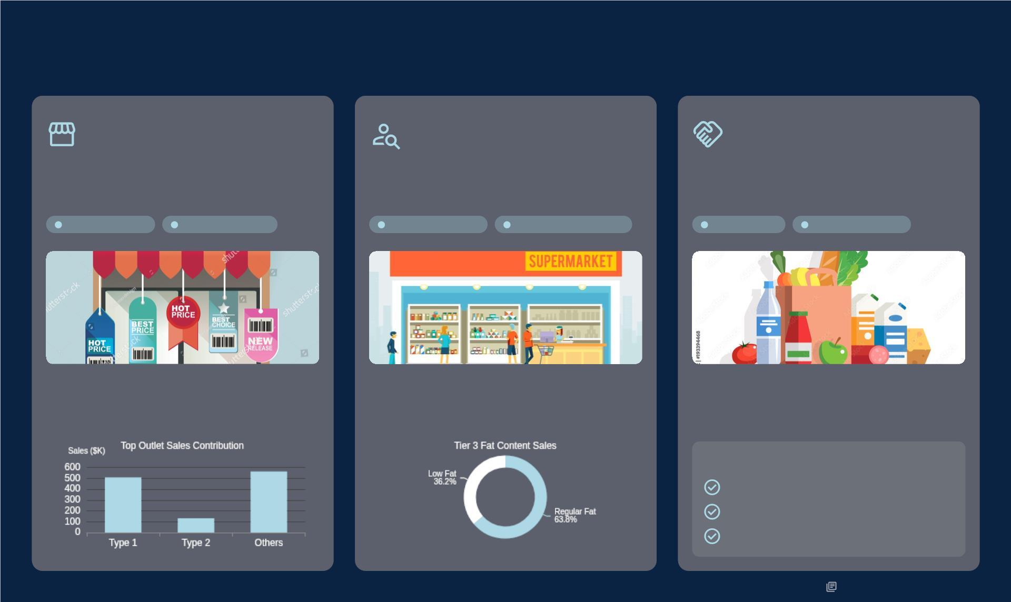
Further Recommendations & Next Steps
Outlet Establishment
Strategy
Customer Behavior
Insights
Optimized Supplier
Partnerships
Analyze factors contributing to the 2018 sales
surge to replicate success.
Investigate purchasing patterns in different outlet
sizes and locations to tailor offerings.
Work with suppliers to ensure consistent
availability of high-demand and low-fat products.
Strategic Growth
Market Expansion
Consumer Insights
Personalized Offerings
Supply Chain
Product Availability
• Identify high-performing outlet models.
• Evaluate locational success factors.
• Replicate proven strategies effectively.
• Segment customers by location & size.
• Identify product preferences per segment.
• Customize inventory and promotions.
• Optimize inventory for popular items.
• Secure stable supply of low-fat products.
• Foster stronger supplier relationships.
Action Plan
Regular stock audits.
Negotiate favorable terms.
Expand supplier network.

Slide 13

The Road Ahead: Sustaining
Leadership
Strategic Imperatives for Blinkit's Continued Success
Blinkit achieved a milestone day by surpassing Amazon
in sales.
Sustained Performance &
Growth
Targeted Strategic Focus
Dynamic Adaptation &
Analytics
High-performing product categories
Optimize outlet types and locations
Strong metrics demonstrated
Continuous data analysis
Leverage opportunities for expansion
Adaptation for market leadership
Snapshot: Outlet Type 1 Sales:
$787.5K
Snapshot: Tier 3 Outlets: $472.1K
Continuous data analysis is key.
venkat198881@gmail.com

